Slide 1


SARVAJANIK COLLEGE OF ENGINEERING AND TECHNOLOGY
COMPUTER ENGINEERING DEPARTMENT
B.TECH III ,SEM-VI
(EVEN-2026)
Open Ended Problem (OEP) Presentation
on
“Bank Fraud Detection System”
Subject Name : Python For Data Science (BTCO13602)
Prepared and Presented by (Group No . : 6)
Rudri Desai (ET23BTCO008)
Krisha Dhola (ET23BTCO009)
Diya Patel (ET23BTCO010)
Kavya Patel (ET23BTCO016)
Masoom Parekh (ET23BTCO031)

Slide 2

Table of Contents
Introduction
Topcis Covered
Dataset Overview
Exploratory Data Analysis
Model Implementation
Prediction on Unseen Data
Observations
Conclusion

Slide 3
Introduction
Banking systems generate large volumes of transaction data daily. Banking fraud refers to unauthorized or illegal transactions carried out to gain financial benefit, and with the rise of digital banking, the risk of such fraudulent activities has significantly increased. Detecting fraud is crucial to prevent financial losses and ensure customer security. Therefore, data science techniques are used to identify unusual patterns and effectively detect and prevent fraudulent transactions.
Objectives
Problem Statement
Perform data preprocessing and EDA
Identify important features influencing fraud
Apply K-Means and Z-Score for anomaly detection.
Build a Logistic Regression model for fraud prediction
Evaluate model performance using appropriate metrics.
Detect fraudulent transactions by identifying anomalies and unusual patterns that deviate from normal banking transaction behavior.

Slide 4

Topics Covered
01
Numpy,Pandas,Matplotlib,Seaborn,Scikitlearn,Scipy,
Data Munging
02
Data loading-csv formate ,Storage -csv formate
03
DataFrame -updating ,creating ,Exporting, importing
Apply Functions: Column & Row Wise
04
Descriptive Statistical Analysis: Spread,Correlation,Outlier Treatment
06
Graphics for univariate, bivariate, multivariate,histograms,scatterplot, box plat, pair plot,pie plot
07
Apply unsupervised(K Means)
Supervised(Logistic Regression)

Slide 5



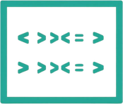
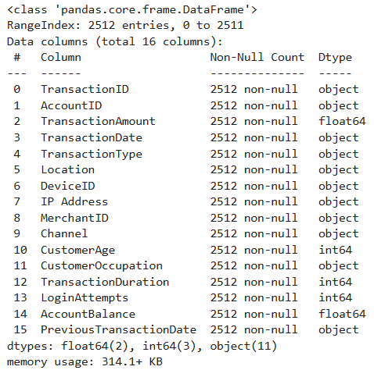
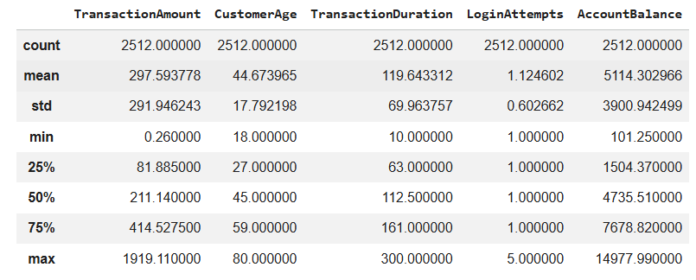
Dataset Overview
Total Records
Features
Data Quality
Data Types
2,512 banking transactions analyzed in this study.
16 total features: 5 numeric, 11 categorical.
No missing values or duplicates detected.
float64 (2), int64 (3), object (11).
Fig.1: Statistical Summary
Fig.2:Summary

Slide 6
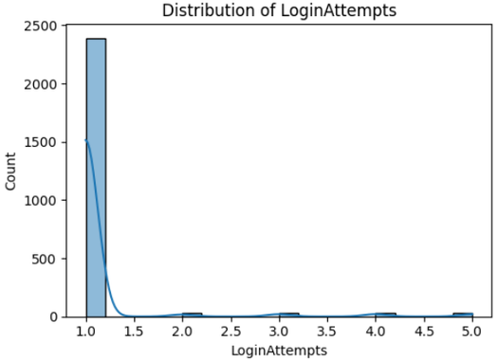
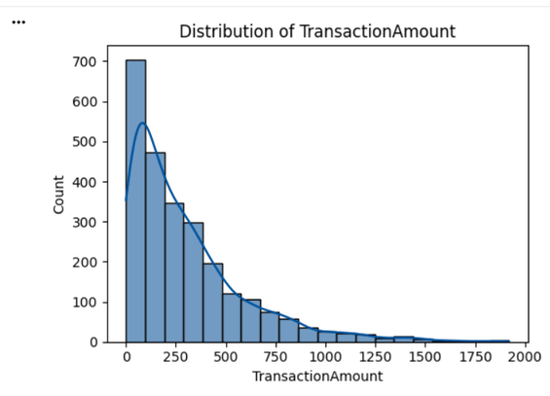
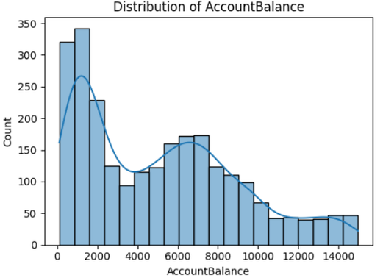
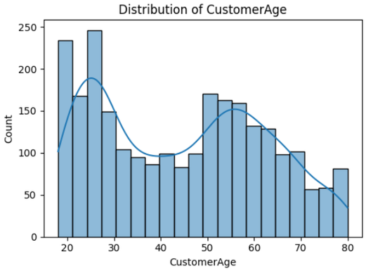
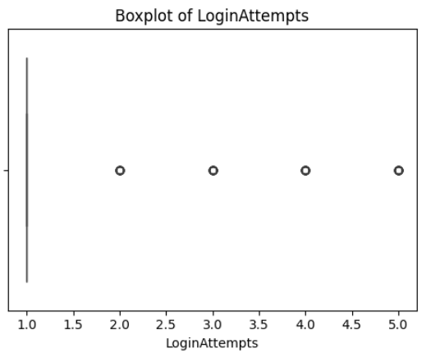
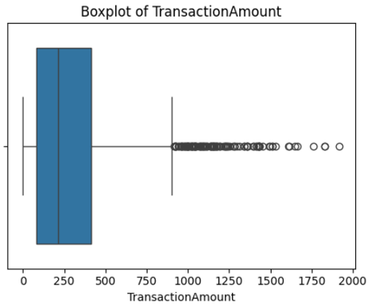
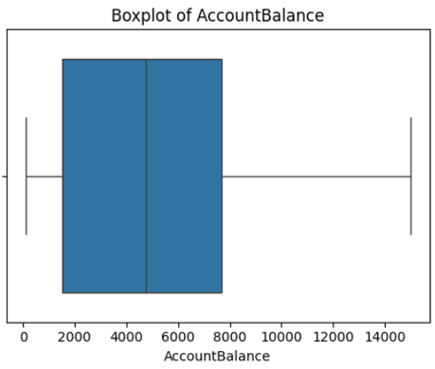
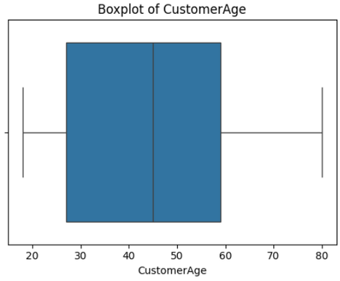
Univariate Analysis :
Numeric Features
Login Attempts
Account Balance
Customer Age
Login Attempts
Transaction Amount
Login Attempts
Login Attempts
Login Attempts
96% have 1 attempt; 2-5 attempts are potential outliers.
Strong right skew — most transactions are small, few are very large. Outliers visible in boxplot — potential fraud signals.
Heavily right-skewed — ~90%+ users make only 1 attempt. Values 2–5 are outliers
96% have 1 attempt; 2-5 attempts are potential outliers.
Right-skewed with a secondary hump around $6,000–$8,000. No extreme outliers.
Heavily right-skewed — ~90%+ users make only 1 attempt. Values 2–5 are outliers
96% have 1 attempt; 2-5 attempts are potential outliers.
96% have 1 attempt; 2-5 attempts are potential outliers.

Slide 7
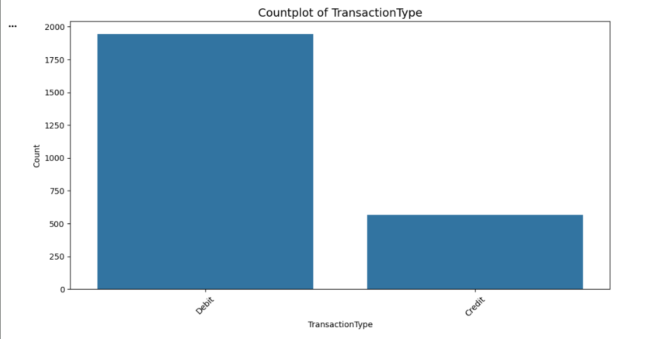
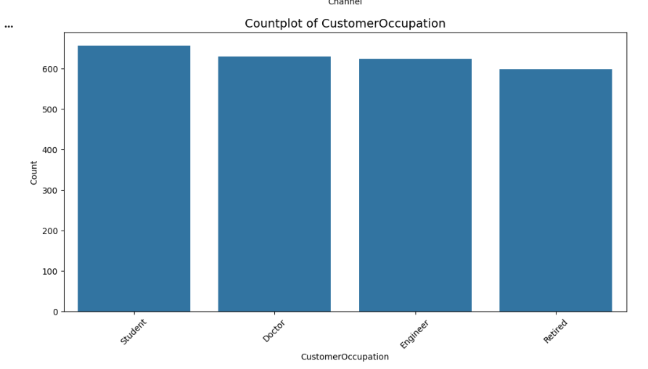
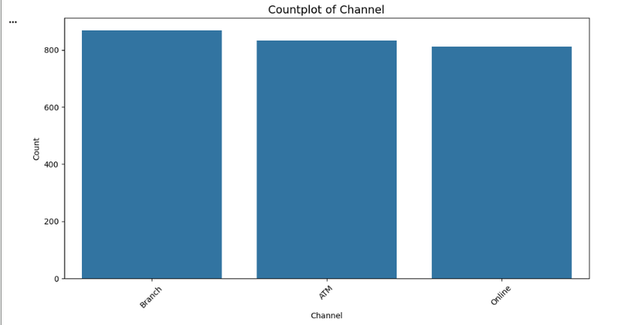
Univariate Analysis :
Categorical Features
Login Attempts
Transaction Type
Customer Occupation
Login Attempts
96% have 1 attempt; 2-5 attempts are potential outliers.
77.4% Debit, 22.6% Credit — heavily imbalanced
96% have 1 attempt; 2-5 attempts are potential outliers.
Fairly balanced across Student, Doctor, Engineer, Retired.
Login Attempts
Transaction Channel
96% have 1 attempt; 2-5 attempts are potential outliers.
Nearly equal split: Branch 34.6%, ATM 33.2%, Online 32.3% — well balanced.

Slide 8
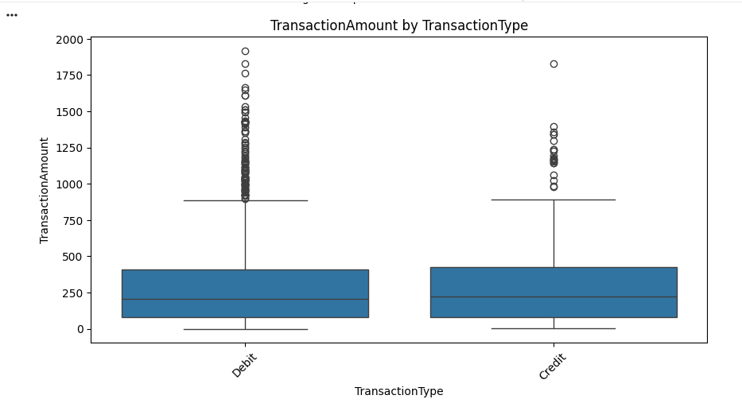
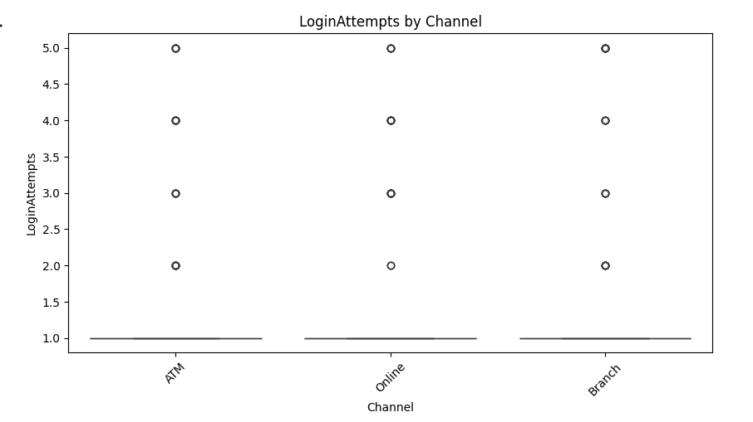
Bivariate
Analysis
Login Attempts
Login Attempts
Transection Amount by TransactionType
Login Attempts by Channel
96% have 1 attempt; 2-5 attempts are potential outliers.
96% have 1 attempt; 2-5 attempts are potential outliers.
Credit is higher-value; debit is more frequent.
More login attempts, especially online, signal possible unauthorized access.

Slide 9
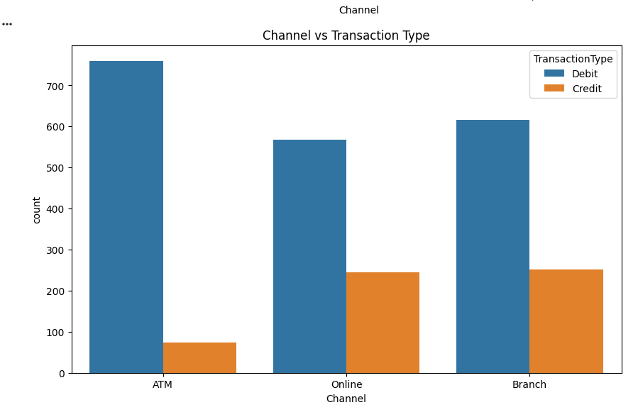
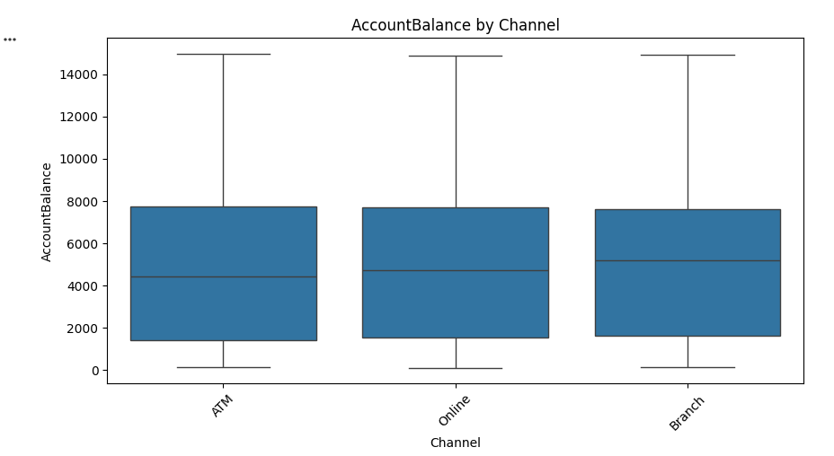
Bivariate
Analysis
Channel vs Transection Type
Login Attempts
Account Balance by Channel
Login Attempts
96% have 1 attempt; 2-5 attempts are potential outliers.
Account balances show similar distributions across all channels, indicating no significant difference in customer profiles
Debit transactions dominate across all channels, especially in ATM, while credit transactions are more balanced in Online and Branch
96% have 1 attempt; 2-5 attempts are potential outliers.

Slide 10
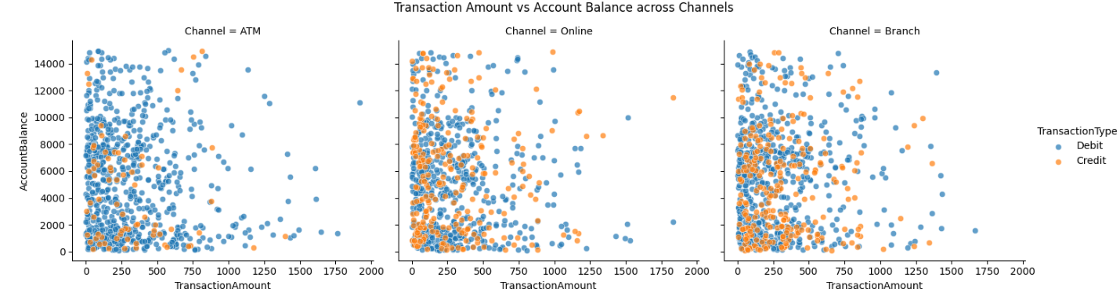
Multivariate Analysis
Login Attempts
The analysis of Transaction Amount vs Account Balance across different channels shows no strong relationship between the variables. The pattern is similar for ATM, Online, and Branch transactions, indicating channel-independent behavior. However, a few high-amount transactions at low balances appear as outliers, which may indicate potential fraud.
96% have 1 attempt; 2-5 attempts are potential outliers.

Slide 11
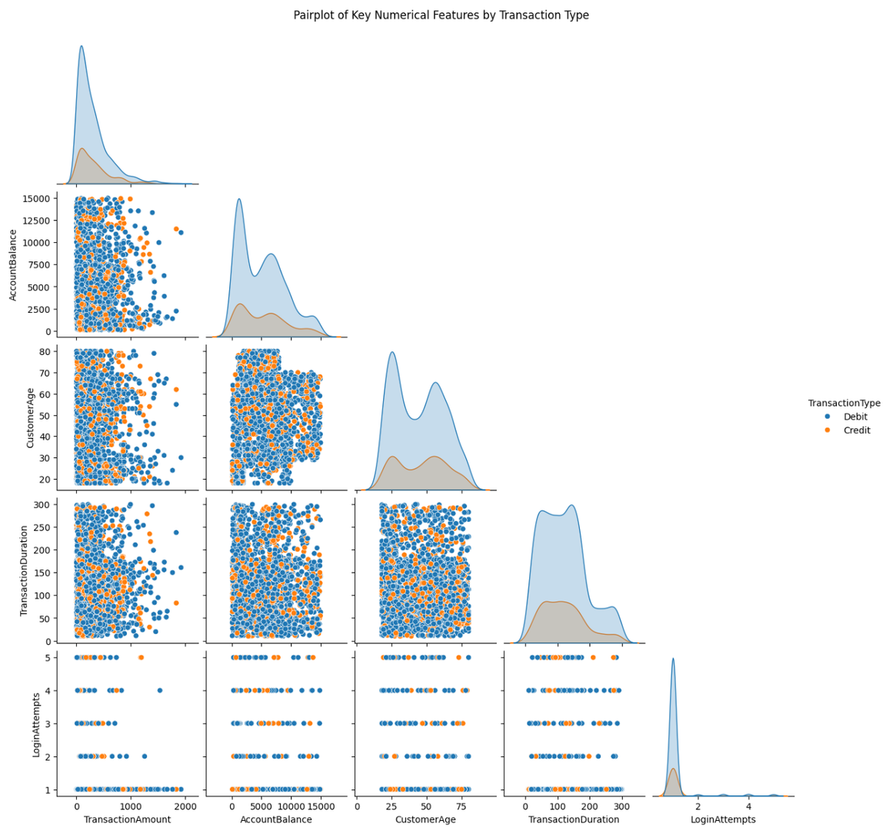
Multivariate Analysis
The strong overlap indicates that individual features cannot clearly separate transaction types or fraud patterns; however, high transaction amounts and multiple login attempts appear as potential anomaly indicators, requiring machine learning for effective fraud detection.

Slide 12
K-Means Clustering
Unsupervised Learning Approach
Standardized Features
Fraud Detection Rule
Key Results
5 clusters applied to numeric features without requiring labeled data.
Amount, Duration, Login Attempts, Balance, Age normalized.
Flag if distance > Mean + 3×SD from cluster center.
20 fraudulent transactions detected (0.8% of total).
Z-Score Analysis
Statistical Approach
Standardized Features
Fraud Detection Rule
Key Results
Detects fraud by identifying extreme deviations in individual features using statistical standardization.
Amount, Duration, Login Attempts, Balance, Age converted into Z-scores.
Flag transactions far from mean
(|Z| > 3 standard deviations)
140 fraudulent transactions detected
(5.6% of total data)

Slide 13
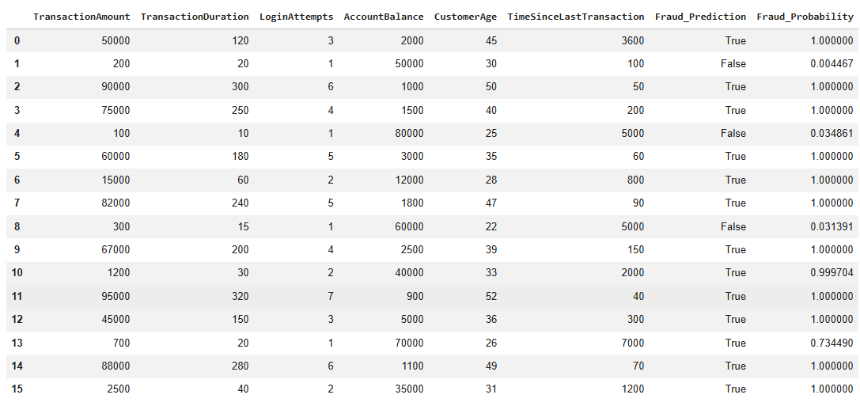
Prediction on Unseen data

Slide 14
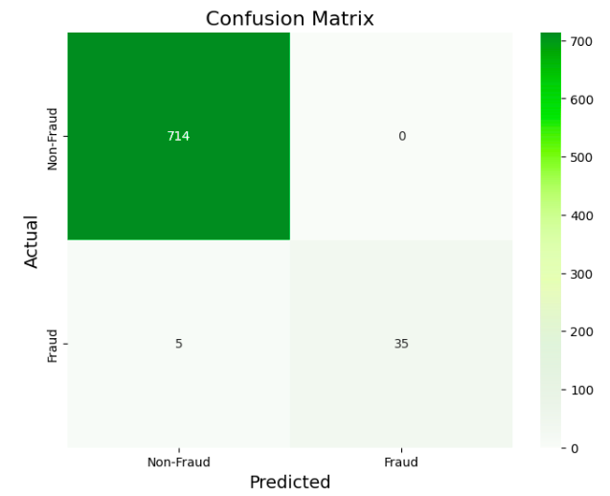
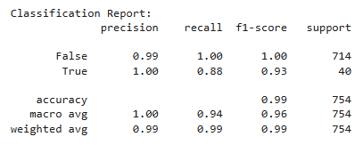
Logistic Regression
Supervised Learning Approach
Input Features
Model Objective
Key Results
Uses labeled data to classify transactions as fraud or non-fraud.
Amount, Duration, Login Attempts, Balance, Age, Time Since Last Transaction.
Predict probability of fraud based on combined feature influence.
140 frauds detecte
Accuracy: 99% Precision: 100% Recall: 88%

Slide 15
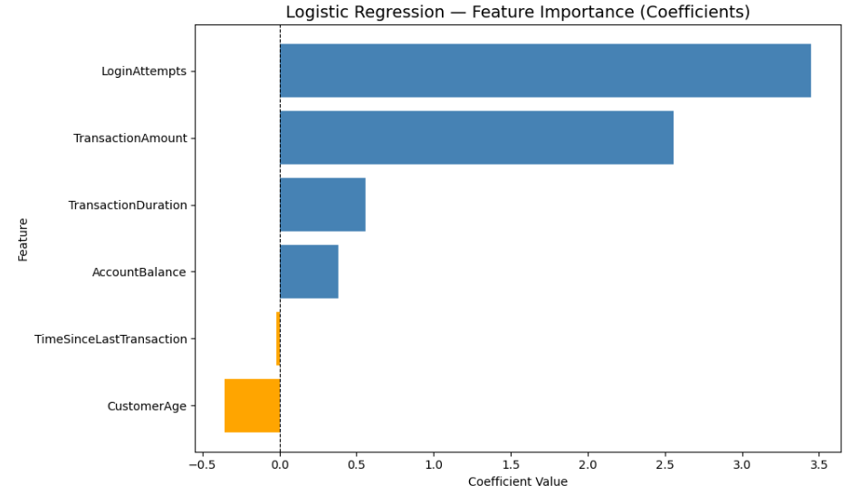
Observations
96% have 1 attempt; 2-5 attempts are potential outliers.
The analysis shows that Login Attempts and Transaction Amount are the most important features influencing fraud detection.

Slide 16
Conclusions
K-Means clustering identified 20 anomalous transactions (0.8%), while Z-Score analysis detected 140 statistical outliers (5.6%). Logistic Regression, which considers all features together, achieved the best performance with 99% accuracy, high precision, and strong recall. Overall, fraud detection is driven by extreme transaction behavior and the combined effect of multiple features rather than any single variable.
Login Attempts
96% have 1 attempt; 2-5 attempts are potential outliers.

Slide 17
Thank
You!

